Slide 1

FALCON INNOVATION CHALLENGE 2022
BIG Ideas Wanted!
The Falcon Innovation Challenge is an opportunity to work together and bring ideas to life that help address our client's critical business needs & challenges. Whether it's building AI/ML infused personalization combined with 5G to provide a immersive experience or using AI for predictive network assurance, or building sustainable tech solutions through servitization and circular economy - participation in the Falcon challenge is the opportunity to identify & prototype innovative solutions leveraging the brightest minds at Capgemini.
What's in it for me?
We believe that in each one of you lies the spirit of a Falcon to rise above and beyond to come forward with your innovative ideas that will help solve customer problems.
Winning teams will be rewarded with $5,000 in cash & prizes
Teams coming up with cross sector & multi-tower ideas/solutions will have an edge.
Recognition on Talent and invitation to attend exclusive TMT Leadership events.
Why is it relevant?
In the constantly evolving VUCA world, we need to collaborate and focus on creating more businesses value for our customers. With a renewed focus on operational efficiency, we need to identify better and more innovative ways to help our clients reduce costs and increase their brand awareness and market share. The Falcon Challenge will help us identify a diverse pool of ideas and talented teams can work together to bring relevant innovative solutions to the market faster.

Slide 2
tIMELINE
Nov 2022
28th Sep – 4th Oct
10th Aug – 21st Sep
20th Jul – 2ndAug
RESULTS
Winners Announcement
Disbursement of Cash Prize
FINALS
Executive Presentations & Demo
1 Week
Phase II
Solution Development & Collateral Submission
6 Weeks
Phase I
Team Formation & Abstract Submission
2 Weeks

Slide 3



2022 Contest Themes
Digital Experience and Intelligent Industry
Network Management through Cloud Software
TCO Reduction and Improvement in Efficiency using Cloud
Accelerate Content Production and Acquisition
Optimize Content Delivery
Enhanced Audience Experiences
Monetize Content
Subscription and Servitization
Scale with Platform Companies
Product Transformation
Sustainability
Telecommunications
Media & Entertainment
High - Tech

Slide 4
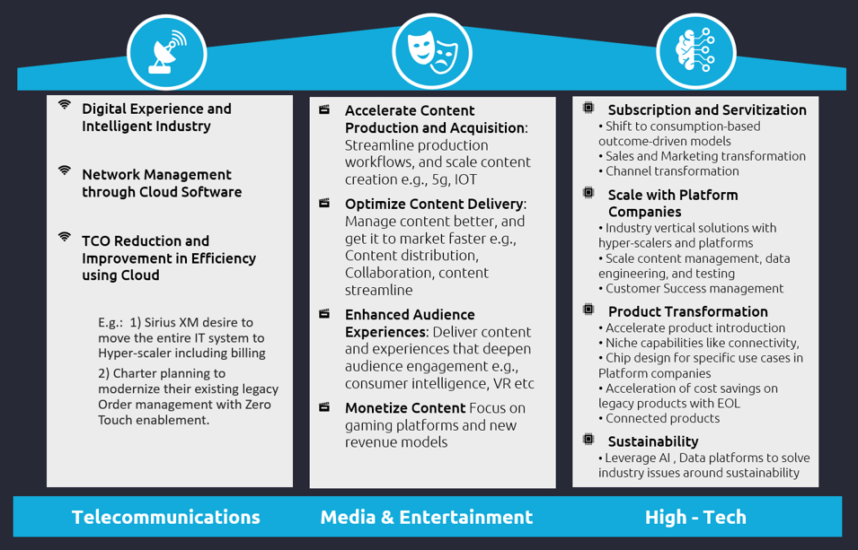
2022 Contest Themes
Digital Experience and Intelligent Industry
Network Management through Cloud Software
TCO Reduction and Improvement in Efficiency using Cloud
Accelerate Content Production and Acquisition
Optimize Content Delivery
Enhanced Audience Experiences
Monetize Content
Subscription and Servitization
Scale with Platform Companies
Product Transformation
Sustainability
Telecommunications
Media & Entertainment
High - Tech

Slide 5
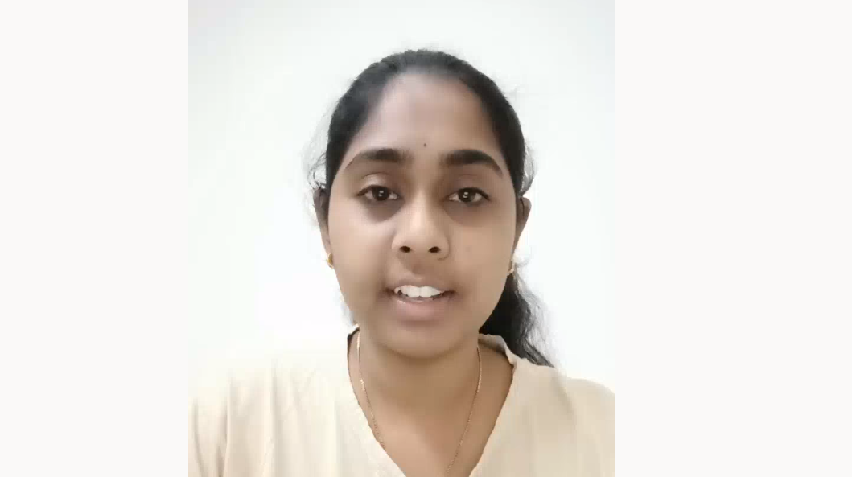
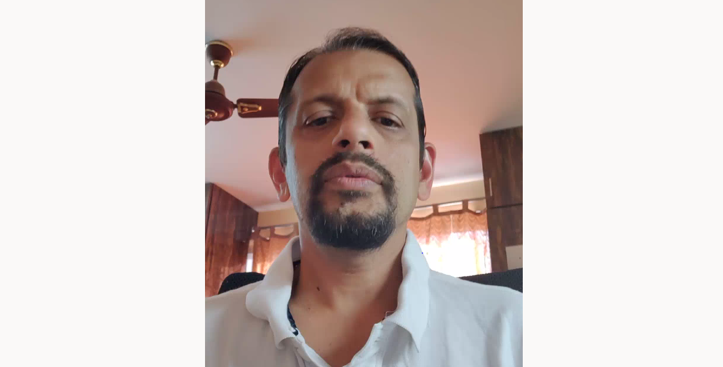
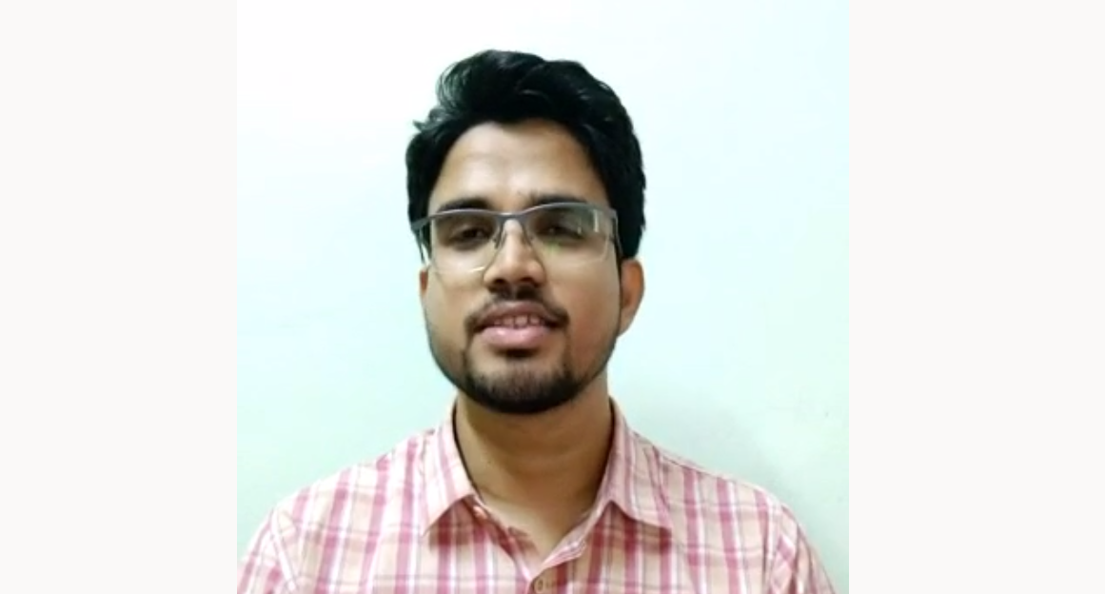
FLASHBACK - Falcon 2021 Highlights
WINNERS
WINNERS SPEAK
138 Teams
40+ POCs
10 Finalists
Cash Prizes
310+ Participants
#1
Virtual Elites
Child Lock - Profanity Filters
#2
Team GCP-LAB
Automating Solutions for Customer Care Problems using AI/ML
5 Winning Teams
#3
Data Trust Strategists
AI driven Intelligent Data Quality
& Value Reconciliation Framework
#3
A-Team
A.Eye - AI powered media analyser
#3
Tech Champs
Shoppable Commerce for OTT Media
View More
Color gradie for manual coloring of charts, smart arts etc.
TEXT
TEXT
TEXT
TEXT
TEXT
TEXT
TEXT
TEXT

Slide 6
Register Now
(Capgemini VPN Access Required)
CLICK HERE TO REGISTER
OR VISIT
tmt-connect.capgemini.com/form/falcon-tmt-innovation-form

